Slide 1

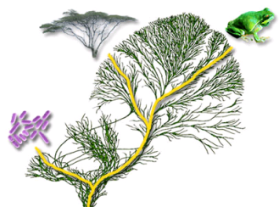





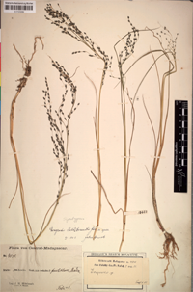
Biodiversity data
DiversityCollection
DiversityDescriptions
Thesauri
DiversityTaxonNames
DiversityReferences
DiversityAgents
DiversityGazetteer
Administration
DiversityProjects
Notes:
Vorstellung der Module
Administration
Users – Benutzerverwaltung, who is who
Projects – Hierarchie, Zugirff auf Daten, Projektweite Einstellungen
Beide Module werden ueber Proxytabellen in andere Module gespiegelt um Unabhaengigkeit zu ermoeglichen
Thesauri
References – Datenbank und Webclient in Berlin entwickelt
Gazetteer – Daten von Getty Museum. wird langsam von Webservices ersetzt (Geonames, Google-Maps)
Agents
ScientificTerms
TaxonNames
Biodiversitätsdaten
SamplingPlots – in Entwicklung
Resources – Datenbank und Webclient in Berlin entwickelt, kaum genutzt, da einfache Bildverwaltung von Modulen selbst abgedeckt wird
Descriptions – noch MS-Access, wuerde auch Oekologische Daten abdecken
Collection

Slide 2
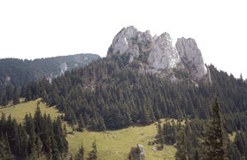
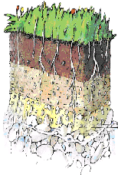
DiversityDescriptions
Biodiversity data
DiversityCollection
DiversitySamplingPlots
Thesauri
DiversityTaxonNames
DiversityReferences
DiversityScientificTerms
DiversityGazetteers
DiversityAgents
Administration
DiversityProjects

Slide 3


SQL Server
DiversityDescriptions
Biodiversity data
DiversityCollection
DiversitySamplingPlots
Thesauri
DiversityTaxonNames
DiversityReferences
DiversityScientificTerms
DiversityAgents
Administration
DiversityProjects

Slide 4




Metadata
Primary source
Cached data
Projects
DescriptionsCache
Description data
Copies of original data
Primary source
Copies of original data
Copies of original data
(+ ProjectID)
Descriptions
Restricted by:
Project
Withhold
Converted data for publication
Specimen
SQL Server
Project dependent transfer type
and conversions
Taxon
Primary source
Collection
Citation
Primary source
Sources for specimen, taxa
etc.
TaxonNames
…
In later versions …
Primary source
References
Specimen data
Citation
data
Primary source
Taxon
Synonymy
… data
…
Notes:
Vorstellung der Module
Administration
Users – Benutzerverwaltung, who is who
Projects – Hierarchie, Zugirff auf Daten, Projektweite Einstellungen
Beide Module werden ueber Proxytabellen in andere Module gespiegelt um Unabhaengigkeit zu ermoeglichen
Thesauri
References – Datenbank und Webclient in Berlin entwickelt
Gazetteer – Daten von Getty Museum. wird langsam von Webservices ersetzt (Geonames, Google-Maps)
Agents
ScientificTerms
TaxonNames
Biodiversitätsdaten
SamplingPlots – in Entwicklung
Resources – Datenbank und Webclient in Berlin entwickelt, kaum genutzt, da einfache Bildverwaltung von Modulen selbst abgedeckt wird
Descriptions – noch MS-Access, wuerde auch Oekologische Daten abdecken
Collection

Slide 5
Metadata
Project definitions
Cached data
Specimen data
DiversityProjects
DiversityCollectionCache
Primary source of data
Copies of original data
DiversityCollection
Copies of original data
Copies of original data
(+ ProjectID)
Project selection
Data withholding
Embargos
Converted data for publication
Taxon data
Restrictions to:
Taxonomoc groups
Material categories
Localisations
Source for taxa
DiversityTaxonNames
Taxon data
Sources for taxa
& sequence of retrieval
Source for taxa
DiversityTaxonNames
Taxon
Synonymy
Source for taxa
DiversityTaxonNames
DiversityTaxonNames
Notes:
Vorstellung der Module
Administration
Users – Benutzerverwaltung, who is who
Projects – Hierarchie, Zugirff auf Daten, Projektweite Einstellungen
Beide Module werden ueber Proxytabellen in andere Module gespiegelt um Unabhaengigkeit zu ermoeglichen
Thesauri
References – Datenbank und Webclient in Berlin entwickelt
Gazetteer – Daten von Getty Museum. wird langsam von Webservices ersetzt (Geonames, Google-Maps)
Agents
ScientificTerms
TaxonNames
Biodiversitätsdaten
SamplingPlots – in Entwicklung
Resources – Datenbank und Webclient in Berlin entwickelt, kaum genutzt, da einfache Bildverwaltung von Modulen selbst abgedeckt wird
Descriptions – noch MS-Access, wuerde auch Oekologische Daten abdecken
Collection

Slide 6








Metadata
Primary source
Cached data
Cached data
Projects
DescriptionsCache
Project
Project
Project
Description
Project
Data of project
Primary source
Project
Descriptions
Data of project
Package
Taxa
Converted data
Restricted by:
Project
Withhold
Specimen
Restrict:
Items
Characters
Scope
types
…
Taxon
Synonymy
Specimen
STOP
…
Key mapping
Taxa
PostgreSQL
Project
SQL Server
Cached data
Primary source
Specimen
TaxonNames
Sources for taxa
Taxon
Synonymy
Project
…
Project
Sources for spec.
Specimen
Taxa
Data of project
Collection
Specimen
…
Taxa, Specimen, …
…
Package
Converted data
Primary source
TaxonNames
Linked
Server
Taxon
Synonymy
Collection
Specimen
…
…

Slide 7

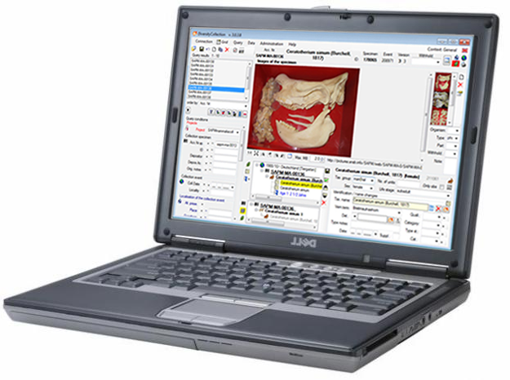
Central data storage
DiversityCollection
Publisher
Central data storage
DiversityCollection
Local copy of data
Publisher
DiversityCollection
Subscriber
Notes:
Vorstellung der Module
Administration
Users – Benutzerverwaltung, who is who
Projects – Hierarchie, Zugirff auf Daten, Projektweite Einstellungen
Beide Module werden ueber Proxytabellen in andere Module gespiegelt um Unabhaengigkeit zu ermoeglichen
Thesauri
References – Datenbank und Webclient in Berlin entwickelt
Gazetteer – Daten von Getty Museum. wird langsam von Webservices ersetzt (Geonames, Google-Maps)
Agents
ScientificTerms
TaxonNames
Biodiversitätsdaten
SamplingPlots – in Entwicklung
Resources – Datenbank und Webclient in Berlin entwickelt, kaum genutzt, da einfache Bildverwaltung von Modulen selbst abgedeckt wird
Descriptions – noch MS-Access, wuerde auch Oekologische Daten abdecken
Collection

Slide 8
Metadata
Primary source
Cached data
Cached data
Projects
DescriptionsCache
Project
Project
Project
Description
Project
Data of project
Primary source
Project
Descriptions
Data of project
Package
Taxa
Converted data
Restricted by:
Project
Withhold
Specimen
Restrict:
Items
Characters
Scope
types
…
Taxon
Synonymy
Specimen
STOP
…
Key mapping
Taxa
PostgreSQL
Project
SQL Server
Cached data
Primary source
Specimen
TaxonNames
Sources for taxa
Taxon
Synonymy
Project
…
Project
Sources for spec.
Specimen
Taxa
Data of project
Collection
Specimen
…
Taxa, Specimen, …
…
Package
Converted data
Primary source
TaxonNames
Linked
Server
Taxon
Synonymy
Collection
Specimen
…
…

Slide 9


Cached data
Cached data
DescriptionsCache
CacheAdmin
cmdshell
5
4
Cache…_Temp
procBcpInitExport
procBcpExport
procBcpRemoveFile
1
PostgresTransfer
6
Cache…_Backup
3
7
Cache…
14
8
CacheUser
Database
Project
9
PostgresBulkExport
10
Project…TransferView…
Cache… csv
11
CacheAdmin
12
2
procBcpViewCreate
13
pg_execute_server_program
COPY FROM PROGRAM
SQL Server
Postgres
iconv sed tr

Slide 10

SQL Server
PostgreSQL
Cached data
Cached data
Cache Database
BcpInit Export
BcpView Create
SQL login: cmdshell
BcpExport
BcpRemove File
Windows account PostgresTransfer
Linux account
Bcp
Bcpconv_devel
Windows login: PostgresTransfer
Shared drive
U:\postgres\
…/exchange/
CacheAdmin

Slide 11
Cached data
Cached data
CollectionCache
CacheAdmin
cmdshell
5
4
Cache…_Temp
procBcpInitExport
procBcpExport
procBcpRemoveFile
1
PostgresTransfer
6
Cache…_Backup
3
7
Cache…
14
8
CacheUser
Database
Project
9
PostgresBulkExport
10
Project…TransferView…
Cache… csv
11
CacheAdmin
12
2
procBcpViewCreate
13
pg_execute_server_program
COPY FROM PROGRAM
SQL Server
Postgres
iconv sed tr

Slide 12


Biodiversity data
Collection
SamplingPlots
Thesauri
TaxonNames
References
ScientificTerms
Gazetteer
Agents
Notes:
Vorstellung der Module
Administration
Users – Benutzerverwaltung, who is who
Projects – Hierarchie, Zugirff auf Daten, Projektweite Einstellungen
Beide Module werden ueber Proxytabellen in andere Module gespiegelt um Unabhaengigkeit zu ermoeglichen
Thesauri
References – Datenbank und Webclient in Berlin entwickelt
Gazetteer – Daten von Getty Museum. wird langsam von Webservices ersetzt (Geonames, Google-Maps)
Agents
ScientificTerms
TaxonNames
Biodiversitätsdaten
SamplingPlots – in Entwicklung
Resources – Datenbank und Webclient in Berlin entwickelt, kaum genutzt, da einfache Bildverwaltung von Modulen selbst abgedeckt wird
Descriptions – noch MS-Access, wuerde auch Oekologische Daten abdecken
Collection

Slide 13





.Net
Framework
installed ?
no
http://www.microsoft.com/downloads/
Microsoft .NET Framework 4.8
yes
Installation
http://www.microsoft.com/downloads/
Database
available ?
Microsoft SQL Server 201x Express
no
Installation
http://www.diversityworkbench.net/Portal/DiversityDescriptions
yes
DiversityDescriptions_Base.MDF
DiversityDescriptions_Base_log.LDF
expand &
attach
http://www.diversityworkbench.net/Portal/DiversityDescriptions
Alternative method - no Windows administrator rights required
DiversityDescriptionsSetup 4.x.x.zip
DiversityDescriptionsSetup 4.x.x.zip
expand
expand
DiversityDescriptionsSetup.msi
DiversityDescriptionsUnpack.bat
install
unpack
DiversityDescriptions
DiversityDescriptions.exe
start
start

Slide 14

.Net
Framework
installed ?
no
http://www.microsoft.com/downloads/
Microsoft .NET Framework 4.8
yes
Installation
http://www.microsoft.com/downloads/
Database
available ?
Microsoft SQL Server 201x Express
no
Installation
http://www.diversityworkbench.net/Portal/DiversityDescriptions
yes
DiversityReferences_Base.MDF
DiversityReferences_Base_log.LDF
expand &
attach
http://www.diversityworkbench.net/Portal/DiversityReferences
Alternative method - no Windows administrator rights required
DiversityReferencesSetup 4.x.x.zip
DiversityReferencesSetup 4.x.x.zip
expand
expand
DiversityReferencesSetup.msi
DiversityReferencesUnpack.bat
install
unpack
DiversityReferences
DiversityReferences.exe
start
start

Slide 15
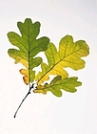
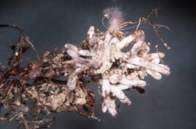

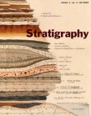
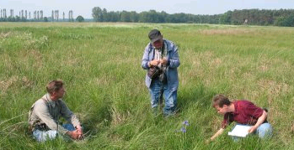
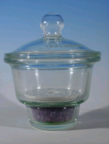
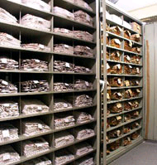
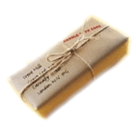

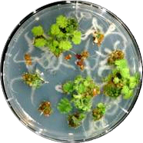
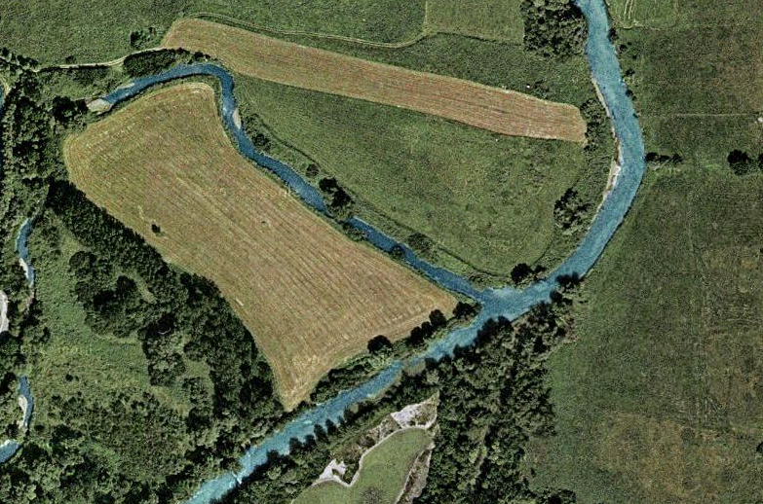
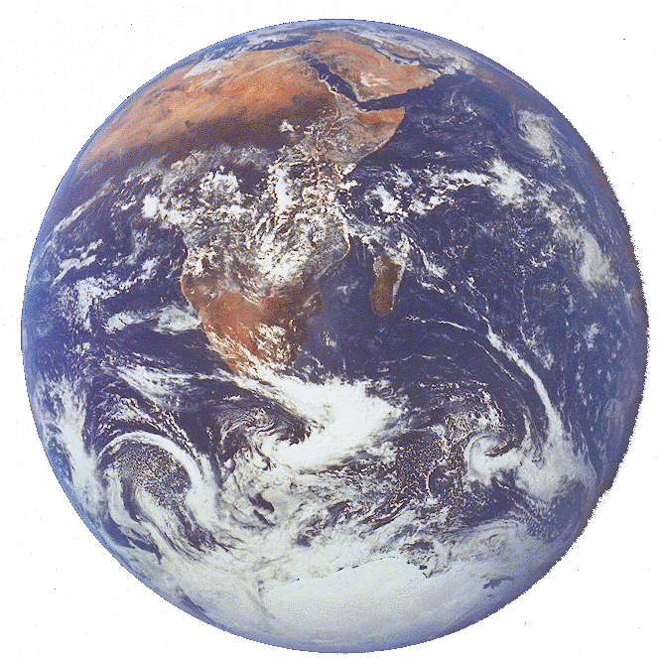
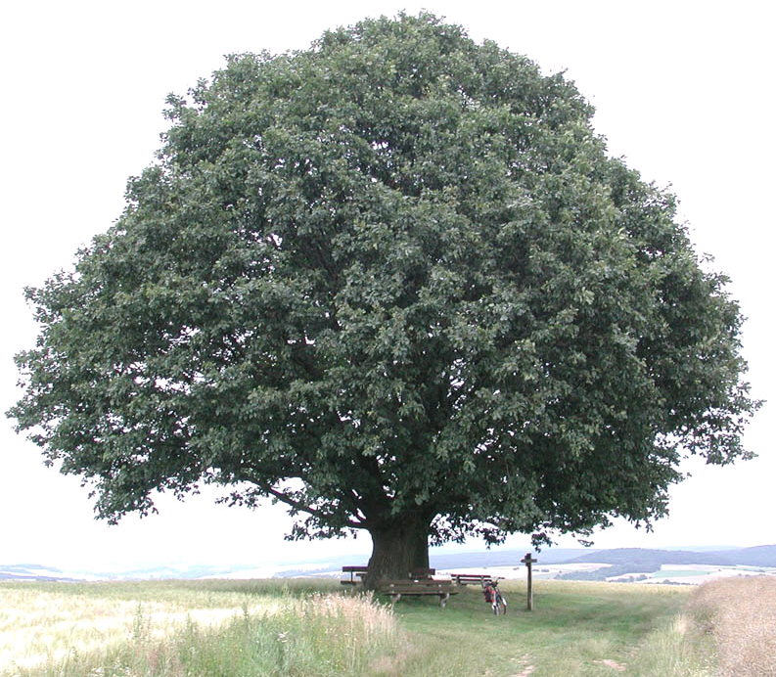
Quercus robur L.
Quercus pendunculata

Slide 16
Quercus robur L.
Quercus pendunculata

Slide 17
Inventory
Sending request
Collection manager
Loan management
Sending loan
Requester
Exchange balance with other collections
Collection

Slide 18
Collection event series
Images
Maintenance
Collection event
History
Images
Label
Localisation (e.g. coordinates)
Property (e.g. vegetation, soil, stratigraphy)
Collection specimen
Collectors
Relations
Images
Images
Projects
Collection
Organisms
Identifications
Request
Analysis
Parts
Requesters
Managers
Processing
Transactions (Loan, exchange etc.)

Slide 19



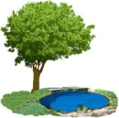



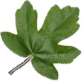
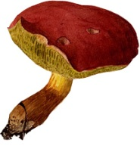







Collection
event
series
Collection
event
Localisation (e.g. Coordinates)
Properties (e.g. habitats)
Collection
specimen
Collectors
Projects
Relations between specimen
Organisms
Boletaceae
Boletus edulis L.
Identifications
Analysis
Coordinates
Collections
Parts
Processing (e.g. DNA extraction)
Transaction (e.g. loan)

Slide 20
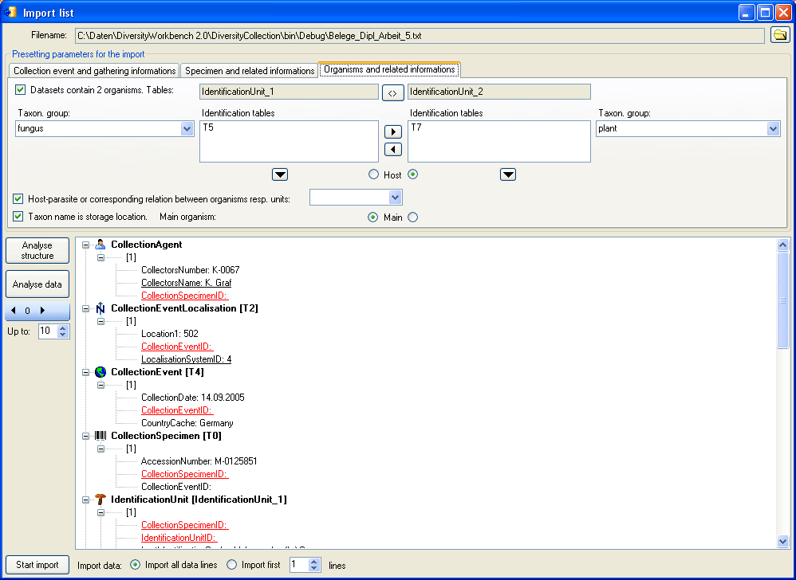
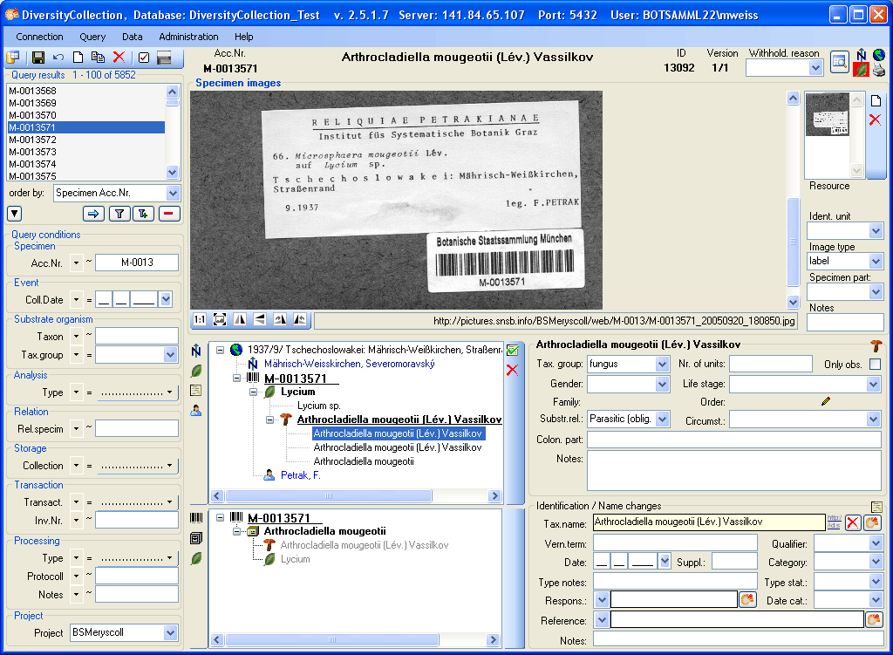
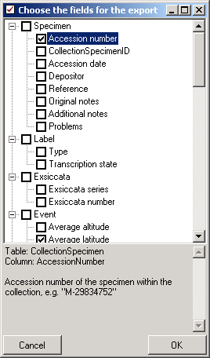
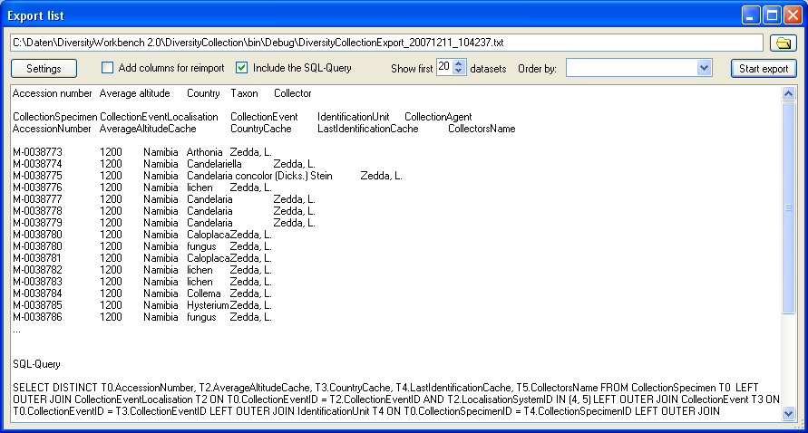
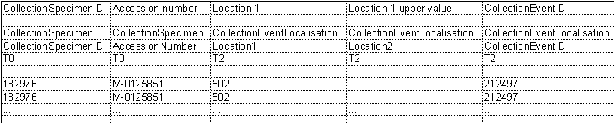
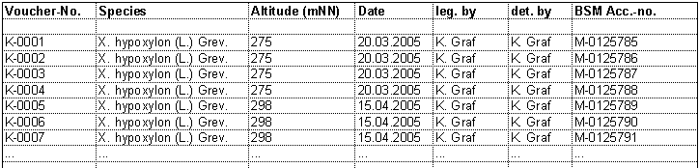
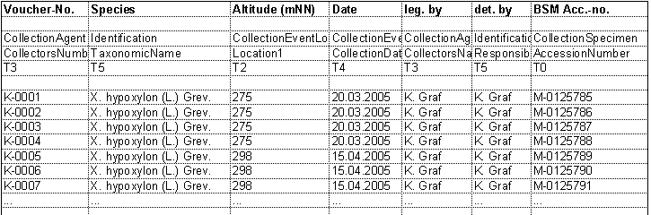
Transfer
your data into a tab-separated text file
OriginalData.txt
Manually enter one dataset into the database
Import your file
Transfer the generated headers to your file
Create an export from this dataset
including the edited colums and the [include columns for reimport] option
DiversityCollectionExport_....txt

Slide 21
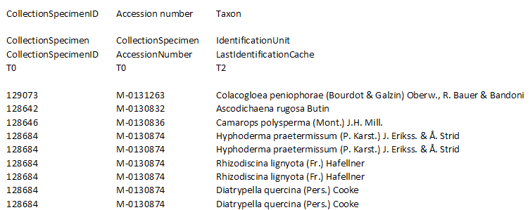

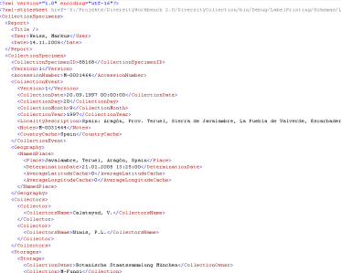

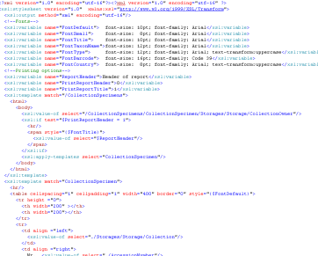
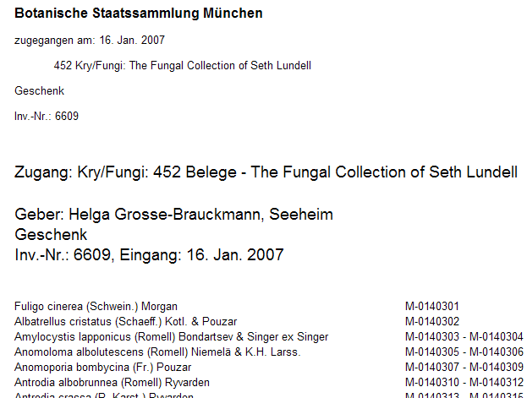
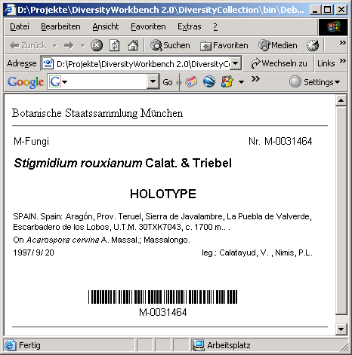
tab-separated
lists
Import
Export
XML
DiversityCollection
ABCD export
Image import
Inventory list
Label
XSLT
XML

Slide 22



remote access
Specimen Collection event Collector
DataWithholdingReason
local access
P r o j e c t s
User groups
Administrator
CollectionManager
DataManager
Editor
Requester
StorageManager
Typist
User
DiversityCollection

Slide 23

data access
P r o j e c t s
User groups
Administrator
ProjectManager
TerminologyEditor
DescriptionsEditor
DataReader
DataUser
DiversityDescriptions

Slide 24

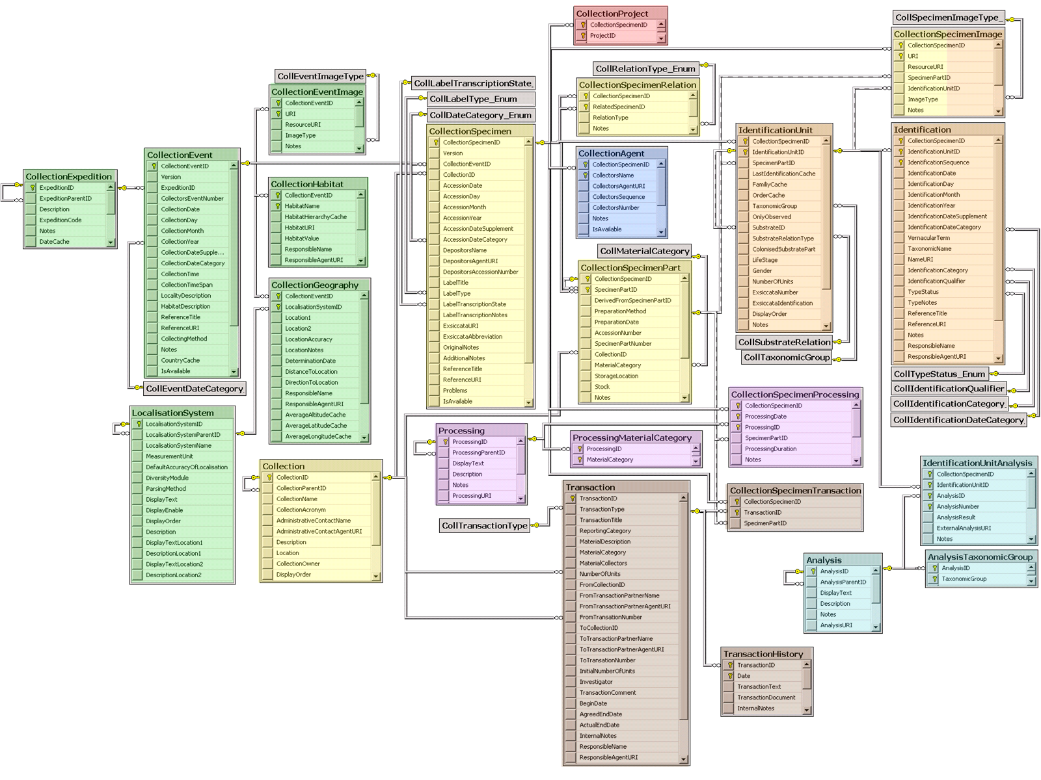


DiversityCollection – Schnittstellen zu anderen Komponenten
DiversityReferences
DiversityProjects
DiversityTerminology
DiversityTaxonNames
DiversityResources
DiversityGazetteer
DiversityAgents
DiversityExsiccatae

Slide 25



DiversityCollection – Specimen Parts

Slide 26
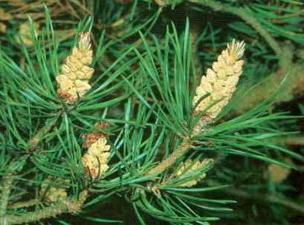
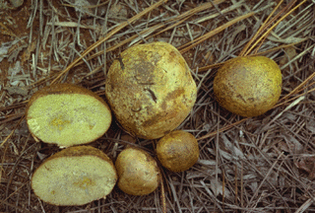
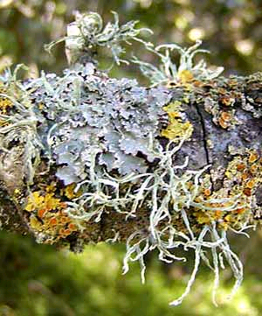
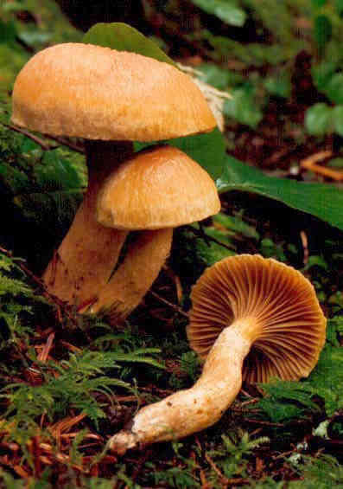
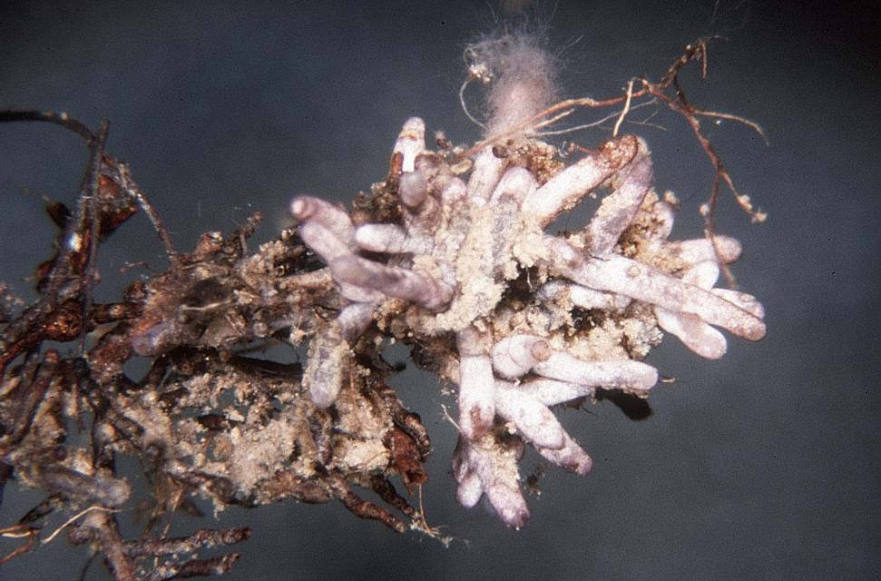
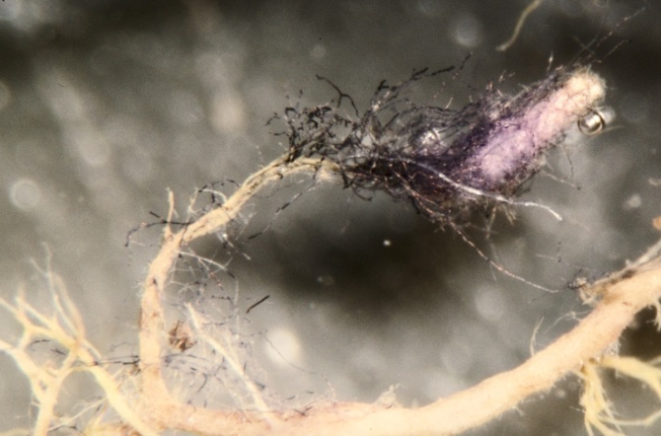
DiversityCollection – Unit hierarchy
Pinus
Rhizopogon
Chroogomphus
Boletus
Suillus

Slide 27
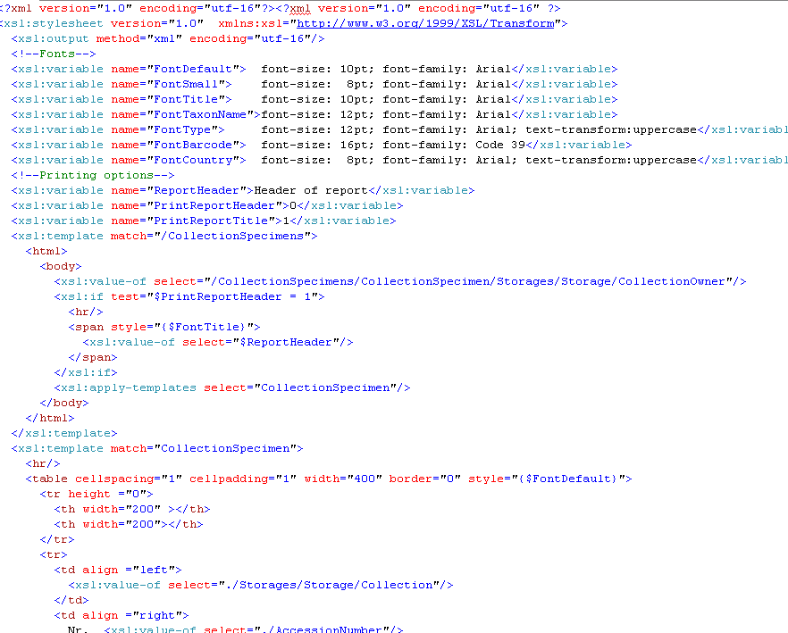

DiversityCollection Client – Label Print
XSLT
XML

Slide 28

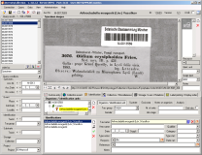
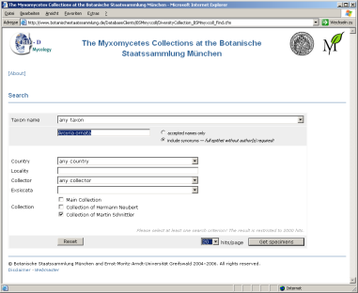

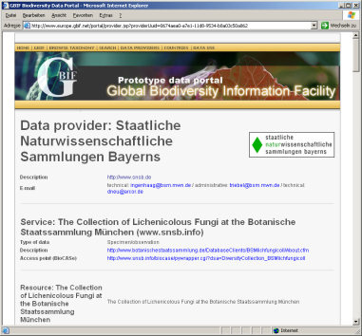

DiversityCollection:
Export, Datenfluss, Präsentation im Internet
CACHE
CACHE
CF
JSP
ABCD
XML
ABCD 2.06
Dateneingabe in
DiversityCollection
Export ausgewählter
Datenfelder
Spiegelung in PostgreSQL und autom. Generierung spezieller ABCD-Tabellen
Präsentation
im Internet

Slide 29
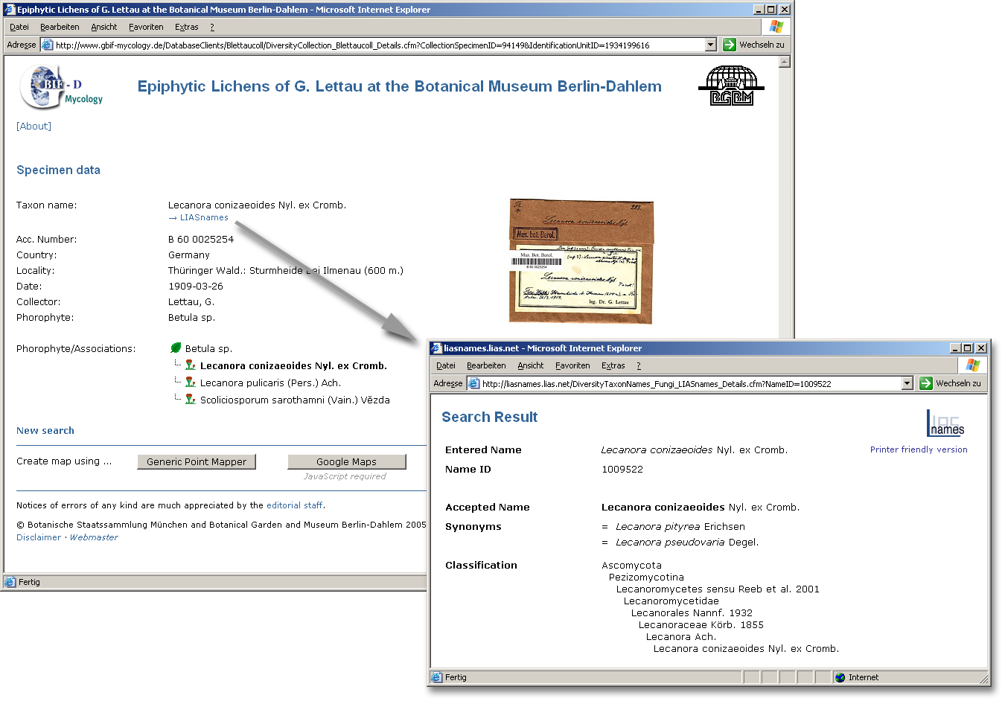
DiversityCollection:
Webschnittstellen – Detailansicht, Verknüpfung

Slide 30
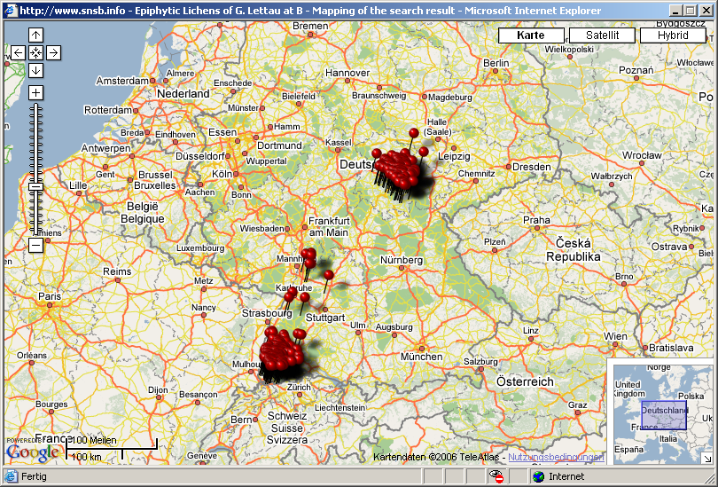
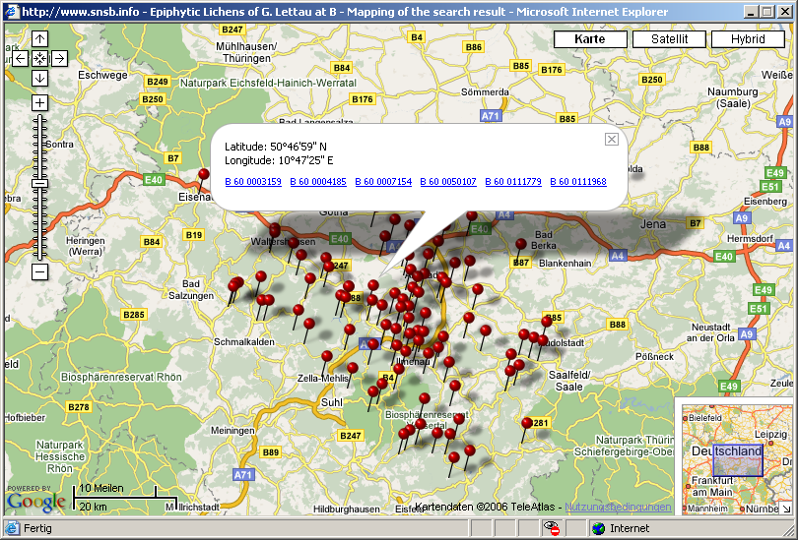
DiversityCollection:
Webschnittstellen – GoogleMaps Webservice

Slide 31
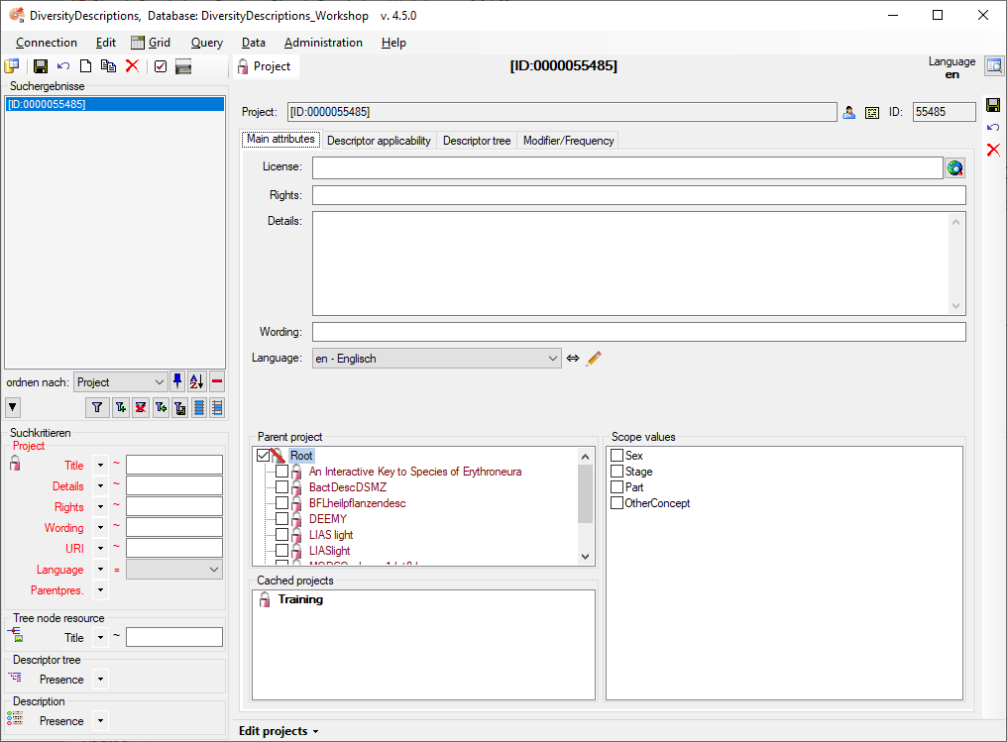
2 – click to enter name of project
4 – save project
1 – create new project
3 – check that project has no parent

Slide 32
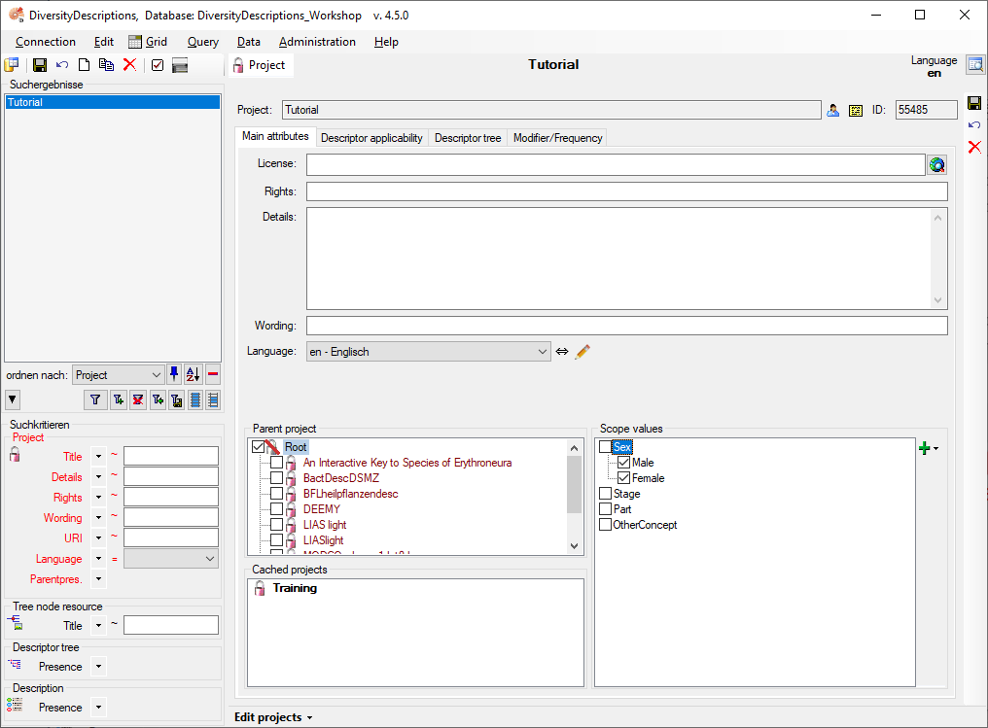
5 – save project
1 – additional project data
2 – select item “Sex“
3 – add
“Female“,
“Male“ etc.
4 – select values

Slide 33
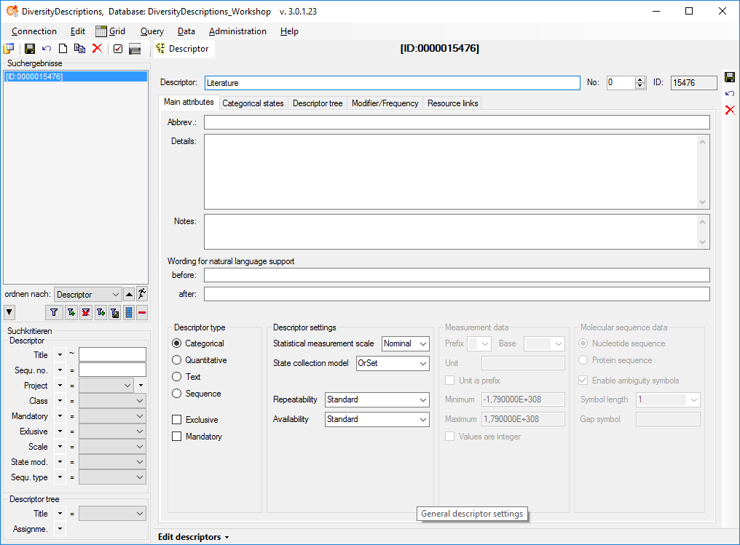
2 – enter descriptor name
4 – set
sequence
number
5 – save
descriptor
1 – create new descriptor
3 – set descriptor type to “Text“

Slide 34
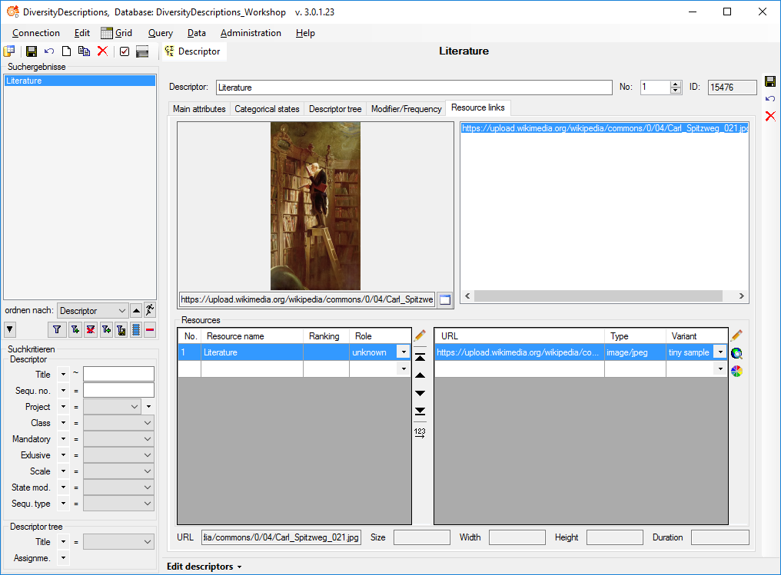
4 – save
descriptor
1 – select
“Resource links“ tab
2 – enter resource name
3 – enter resource link

Slide 35
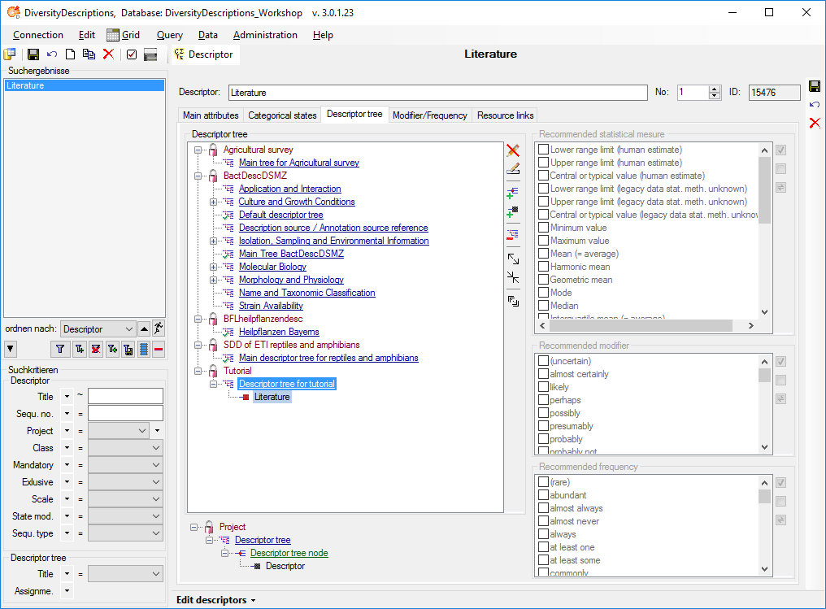
1 – select
“Descriptor tree“ tab
5 – save
descriptor
4 – click on button
“Append descriptor“
2 – right-click project
“Tutorial“ and select
“Add descriptor tree“
3 – right-click the new
descriptor tree and select
“Edit name“ to rename it

Slide 36

2 – enter descriptor name
4 – select main tab
3 – set
sequence
number
8 – save
descriptor
1 – create new descriptor
5 – set descriptor type to “Quantitative“
7 – enter
minimum 0 and
maximum 100
6 – enter
Measurement
unit “cm“

Slide 37

2 – enter descriptor name
4 – select main tab
3 – set
sequence
number
6 – save
descriptor
1 – create new descriptor
5 – check descriptor type “Categorical“

Slide 38

1 – select “Categorical states“ tab
2 – enter state names
3 – save
descriptor

Slide 39

6 – save
descriptor
1 – select
categorical
state
5 – select
color and confirm with “OK“
3 – select entry for
resource variant
2 – enter
resource
name
4 – click button
for color selection

Slide 40

2 – enter descriptor name
3 – select main tab
6 – save
descriptor
1 – create new descriptor
4 – check descriptor type “Categorical“
5 – set the “Mandatory“ flag

Slide 41

2 – enter description name
4 – save
description
1 – create new description
3 – check the project

Slide 42

1 – enter “Descriptor view“ tab
4 – save
description
3 – set the
categorical
state “Tree“
2 – select
the descriptor
“Plant growth type“

Slide 43

4 – save
description
1 – select
the descriptor
“Literature“
2 – square indicates
“resources available“
double-click to view
3 – set data status
“Data unavailable“

Slide 44

2 – save
description
1 – enter “5“ for
“Minimum value“
and “10“ for
“Maximum value“

Slide 45

5 – save
description
2 – select state “green“
3 – square indicates
“resources available“
double-click to view
1 – select
the descriptor
“Leaf color“
4 – use arrow keys “<“ and “>“ on
keyboard to view multiple resources

Slide 46

1 – select main tab
5 – save
description
4 – click to set external link
3 – select scope
type “Taxon name“
2 – insert
new scope
(if visible)

Slide 47

1 – select
“CatalogueOfLife“
4 – select matching result
3 – start search
2 – enter search string
“ulmus camp“
5 – click “OK“

Slide 48

3 – start search
2 – set “Descriptor tree - Assignement“ to “missing“ (Ø)
1 – set “Edit descriptors“

Slide 49

1 – select the description
3 – create document
2 – select options:
“Include resources“
“Include descriptors“

Slide 50

4 – select “Descriptor tree“ tab
3 – select project “Tutorial“
5 – expand all trees
2 – start search
1 – set “Edit projects“

Slide 51

2 – move it up or down within the tree
1 – select a descriptor

Slide 52

2 – organize modifier values
3 – organize frequency values
1 – set “Edit projects“

Slide 53

4 – save changes
1 – select “Descriptor tree“ tab
2 – select descriptor
3 – select modifier values

Slide 54

6 – save changes
3 – select “Descriptor view“ tab
4 – select descriptor
5 – select modifier values
2 – start search
1 – set “Edit descriptions“

Slide 55

3 – select “Descriptor applicability“ tab
6 – add dependent descriptor
4 – select
controlling descriptor
5 – select state
7 – select
dependent descriptor
2 – start search
1 – set “Edit projects“

Slide 56

2 – save changes
1 – check rule

Slide 57

3 – select “Continuous view“ tab
5 – select controlling descriptor
7 – check dependent
descriptors
4 – expand tree
6 – change state to “Succulent“
2 – start search
1 – set “Edit descriptions“

Slide 58


Select all values
Select all values

Slide 59




Project
Descriptive Data
Terminology
Description
Descriptor Tree
Categorical Summary Data
Categorical Descriptor
Description Scope
Quantitative Summary Data
Categorical State
Text Descriptor Data
Quantitative Descriptor
Molecular Sequence Data
Descriptor Status Data
Text Descriptor
Links to other
Diversity Workbench
modules
Sequence Descriptor
Descriptions / Items
Values / States
Descriptors / Characters

Slide 60
Project
“Tutorial“
Descriptive Data
Terminology
Description
“Example plant“
Descriptor Tree
“Descriptor tree for tutorial“
“Plant growth type“
Description Scope
Categorical Summary Data
“Tree“
Quantitative Summary Data
“Leaf color“
Ulmus minor
Min = 5
Max = 10
“green“
“Leaf length“ [cm]
Descriptor Status Data
Links to other
Diversity Workbench
modules
Data unavailable
“Literature“
Descriptions / Items
Values / States
Descriptors / Characters

Slide 61

1
3
2
5
4

Slide 62
Project
Details
Description
Sample Data
Terminology
Descriptor Tree
Date/Time
Sampling Event
Geographic Coordinates
Sampling Unit
Categorical Descriptor
Categorical Sampling Data
Categorical State
Geographic
Location
Quantitative Sampling Data
Quantitative Descriptor
Text Sampling Data
Text Descriptor
Molecular Sequence Sampling Data
Link to
Diversity Gazetteers
Sequence Descriptor
Descriptions / Items
Values / States
Descriptors / Characters

Slide 63






Tab
separated
lists
File conversion
Import
Export
XML file check
Line number Description Name
1 Abierhiza fascicularis + Abies Abies
2 Abierhiza tomentosa + AbiesAbies
3 Acephala macrosclerotiorum 4
4 Afzeliaerhiza beninensis + Afzelia
5 Albatrellus ovinus (Schaeff.: Fr.)
7 Afzeliaerhiza beninensis 8 Albatrellus ovinus (9
9 Afzeliaerhiza beninensis + Afzelia
11 Albatrellus ovinus (Schaeff.: Fr.) Kotl. &
List
export
Import
wizard
Matrix wizard
DiversityDescriptions
Archive
CSV export
Questionnaires
DELTA import
SDD import
Structured export
Cache database

Slide 64





Media WIKI
HTML
Semantic Media WIKI
DiversityDescriptions
Dependency tree
Pensoft

Slide 65
Tab
separated
lists
Import
Export
Image import
Import
wizard
XML
DiversityCollection
ABCD export
Export
wizard
Archive
XSLT
Label, Inventory list
XML
Replication
Cache database

Slide 66

1
2
1
3

Slide 67


